Slide 1
Multi-Sensor Border Threat Detection & Classification System
Land and Air Intrusion Detection using Sensor Fusion
Presented by:
Jaisy Sunil
Jacob Thomas
Hridhya Krishna
Abel Yeshudas
B.Tech – Electronics & Communication Engineering (S4)

Slide 2
INTRODUCTION
Border surveillance is a critical requirement in modern defence systems
Threats can enter through:
Land (human intruders, vehicles)
Air (drones, UAVs)
Traditional single-sensor systems:
Generate false alarms
Fail to classify the type of intrusion
This project proposes a multi-sensor intelligent detection system

Slide 3
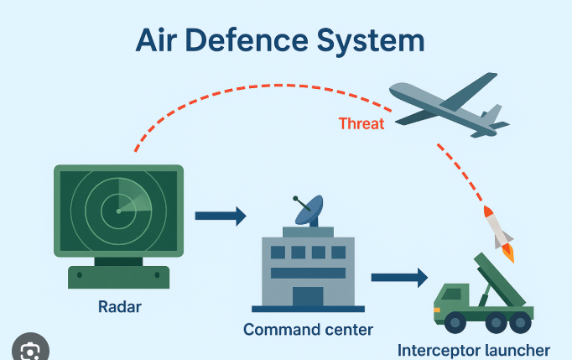
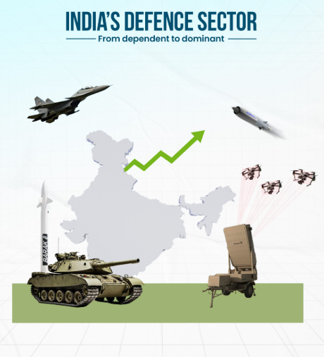
Problem Statement
Detect intrusion in border areas effectively
Distinguish land-based and air-based threats
Reduce false alarms due to:
Birds
Animals
Environmental noise
Design a low-cost, scalable, student-level prototype

Slide 4
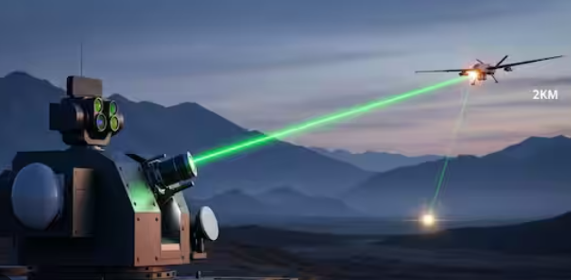
Objectives
Detect intrusion through ground and air
Classify land intrusion into:
Human movement
Vehicle movement
Classify air intrusion into:
Drone
Bird / Safe object
Implement sensor fusion logic
Generate real-time alerts and threat levels

Slide 5
System Overview
The proposed system consists of:
Ground vibration sensing unit
Acoustic sensing unit
Passive RF sensing unit
Embedded controller (Arduino / ESP32)
Display and alert unit
The system functions as a border surveillance node.

Slide 6
Block Diagram
Evide block diagram venam…..ath varakanam

Slide 7
Ground Vibration Sensor (Land Detection)
Detects mechanical vibrations on the ground
Used to identify land-based intrusions
Classification logic:
Low-amplitude periodic vibrations → Human footsteps
High-amplitude continuous vibrations → Vehicle movement
Output:
LAND: HUMAN
LAND: VEHICLE

Slide 8
Acoustic Sensor (Drone vs Bird Detection)
Uses a microphone to monitor sound patterns
Drones generate steady buzzing sounds
Birds produce irregular, short-duration chirps
Sound-based classification:
Continuous stable sound → Drone-like
Random peaks → Bird / noise

Slide 9
Passive RF Detection Unit
Monitors wireless signal activity in the surrounding area
Drones rely on RF communication with controllers
High RF activity indicates:
Possible drone control signals
Suspicious air activity
Advantage:
Passive detection
No signal transmission (stealthy)

Slide 10
Embedded Controller Unit
The system is implemented using:
Arduino or ESP32, based on availability
Functions of the controller:
Sensor data acquisition
Pattern recognition
Sensor fusion
Threat classification
Output control

Slide 11
Sensor Fusion Concept
Individual sensors may generate false alarms
Combining multiple sensors improves accuracy
Example:
RF activity + drone-like sound → Drone confirmed
Sound only → Possible threat
No RF + bird sound → Safe zone

Slide 12
Decision Logic
Step 1: Check ground vibration sensor
Step 2: Check acoustic sensor
Step 3: Check RF activity
Step 4: Apply classification rules
Step 5: Display threat type and alert level
This rule-based logic simulates defence decision systems.

Slide 13
Threat Level Classification
Low Threat (Green):
Bird noise
No RF activity
Medium Threat (Yellow):
Single sensor trigger
High Threat (Red):
Confirmed drone
Vehicle movement

Slide 14
Output and Alert System
LCD Display:
SAFE ZONE
LAND: HUMAN
LAND: VEHICLE
AIR: DRONE CONFIRMED
LED Indicators:
Green → Safe
Yellow → Warning
Red → Danger
Buzzer for audible alert

Slide 15
Prototype Model Design
Ground section contains vibration sensor
Elevated tower contains acoustic and RF sensors
Control unit contains controller, LCD, and alerts
Designed to resemble a border surveillance post

Slide 16
Advantages of the System
Low-cost and compact
Reduced false alarms
Modular and scalable
Operates in low visibility conditions
Defence-oriented architecture

Slide 17
Limitations
Limited detection range
Basic sound classification
Environmental noise may affect accuracy
Prototype-level implementation

Slide 18
Future Scope
AI-based sound and vibration analysis
Long-range communication (LoRa / GSM)
Thermal detection for camouflaged intruders
Direction-based threat detection
Centralized monitoring dashboard

Slide 19
Conclusion
Multi-sensor approach improves intrusion detection accuracy
Sensor fusion enables intelligent threat classification
The prototype demonstrates a realistic defence surveillance concept
Suitable for further research and real-world expansion

Slide 20
THANKYOU PAGE

